Slide 1
Chapter 1 What is Sport and Why Do We Study It?
C H A P T E R
15
Tolerate, Treat, Transfer and Terminate

Slide 2
The 4Ts of Hazard Response
Generally speaking, it is only priority significant risks that require attention at the most senior level
The benchmark test for significance should be set at a level that represents a significant impact for the organization
For hazard risks, the range of responses available is often described as the 4Ts

Slide 3
The 4Ts of Hazard Response
4Ts | Description
Tolerate (Accept/retain) | The exposure may be tolerable without any further action being taken. The ability to do anything about some risks may be limited, or the cost of taking any action may be disproportionate to the potential benefit gained.
Treat (Control/reduce) | The greater number of risks will be addressed in this way. Action is taken to constrain the risk to an acceptable level.
Transfer (Insurance/contract) | This might be done by conventional insurance, or it might be done by paying a third party to take the risk in another way. This option is particularly good for mitigating financial risks or risks to assets.
Terminate (Avoid/eliminate) | Some risks will only be treatable, or containable to acceptable levels, by terminating the activity.

Slide 4
The 4Ts of Hazard Response
Impact
Transfer the risk to another party
Terminate the activity generating the risk
Tolerate the risk and its likely impact
Treat the risk to reduce the likely impact or exposure
Likelihood

Slide 5
Strategic Risk Response
Potential reward
Mature organization
Exploit opportunity until competitors arrive
Expand depending on risk appetite and capacity
Exist in mature/declining markets
Explore entrepreneurial opportunities
The 4Es of opportunity management
Level of risk

Slide 6
Strategic Risk Response
Potential reward
Exit if risk appetite is exceeded
Exploit opportunity until competitors arrive
Expand depending on risk appetite and capacity
Exist in mature/declining markets
Explore entrepreneurial opportunities
Level of risk

Slide 7
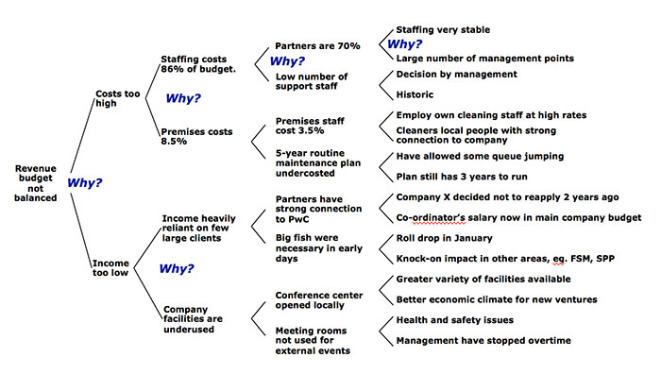
5 Whys Root Cause Analysis

